Slide 1
Surrey SEHM Specialist Free School Proposer Group Engagement Session 1
Tuesday 25 April 2023

Slide 2
Agenda:
Welcomes and introductions
Surrey’s current Local Offer and Local Strategy
Forecast demand for SEMH designated specialist school places in Surrey
The proposed school, its location and funding for pupil places
Create: Schools free offer to proposer groups
Assessment Criteria against the published School Specification
Assessment and Interview Panel members
Next steps and key timescales
Questions & Answer Session

Slide 3
Surrey Local Offer and Strategy for CYP with SEMH Needs
The Surrey Inclusion and Additional Needs Partnership Strategy (2023 to 2026) sets out our ambition that all Surrey children and young people (CYP) with additional needs and/or disabilities and their families (including CYPS with SEMH needs):
are heard and are involved in the decisions that affect them
achieve positive outcomes, including the opportunity to lead healthy lives
develop positive relationships
learn and achieve their educational potential, and
become increasingly independent where possible and flourish within their community
Please see full details of our Strategy on the following link - https://www.surreylocaloffer.org.uk/practitioners/resources/surrey-inclusion-and-additional-needs-partnership-strategy-2023-to-2026 (IAN Partnership Strategy)
There are links and dependencies with the IAN Partnership Strategy and the Health & Wellbeing Strategy. Please see full details of Surrey Health and Well-being Strategy - https://www.healthysurrey.org.uk/about/strategy
Increasing capacity and expertise in our Specialist SEMH school offer, is an important part of our ambitions for this group of children, who are some of our most vulnerable, with multiple layers of disadvantage
Our anticipation is the successful sponsor will provide high quality education for our CYPs with SEMH needs requiring specialist education, along with adding to our expertise in this space to support our inclusive practice for this cohort
Ensuring CYPs with SEMH needs can be educated closer to home is another important part of this development to our offer.
Notes:
Mindworks Surrey, S&BP NHS Foundation Trust, Barnardo's, Learning Space, NAS, SWP, T&P NHS Foundation Trust, SCC

Slide 4
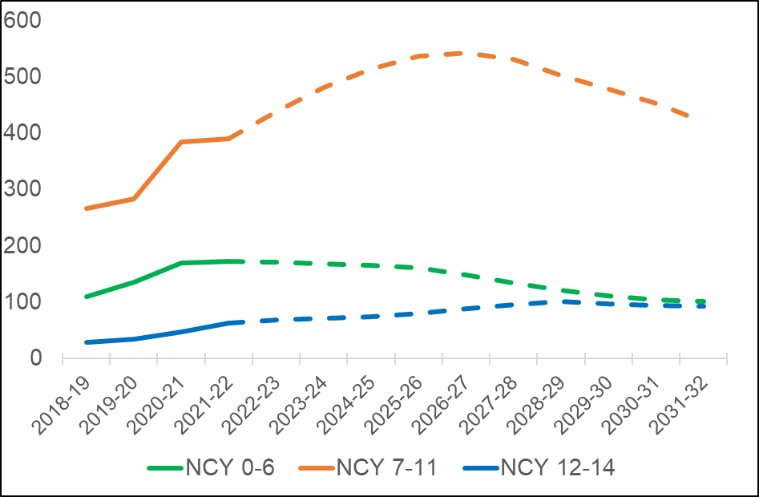
Forecast demand for SEMH Specialist Free School Provision in Surrey
In the North of the county there is a forecast shortfall of 219 places for pupils with social, emotional and mental health needs aged 11-19 years

Slide 5
The Proposed SEMH Specialist Free School
SCHOOL SPECIFICATION | SUMMARY
Type of School | Specialist Free School (Academy)
Designation | Social, Emotional & Mental Health needs (pupils working at broadly age-related expectations with co-occurring needs)
Commissioning Authority | Surrey County Council
School Capacity | Up to 170 places (all to be commissioned by Surrey County Council)
Age Range | 11-19 years
Per Pupil Revenue Funding (Place Funding + Top Up + TP&PG) | KS3: £22,856.38 KS4: £23,641.53 KS5: £24,818.23
Gender | Co-educational
Type of Placements | Full time day placements
Number of 16-19 placements | 20
Planned Outreach | It is expected the successful sponsor will build networks with their local school community, along with sharing their expertise to support partners to include and successfully educate mainstream pupils with SEMH needs. The new school will also be required to work with Surrey’s Mental Health Schools based Team (Mindworks) to support the emotional well-being and mental health of their pupils.
Capital Funding and Delivery | Department for Education
Class sizes | 6-8 pupils

Slide 6
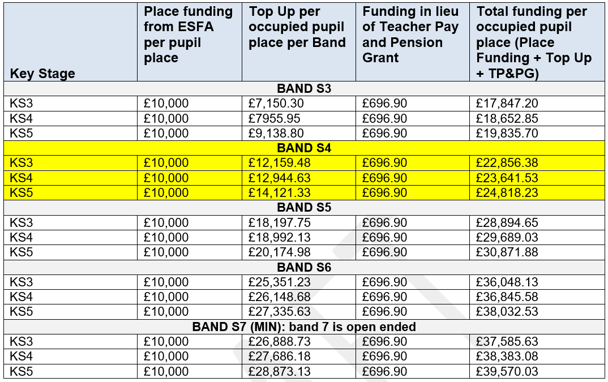
Funding for Pupils with SEMH Needs
Each pupil will attract base funding of £10,000 from the Education and Skills Funding Agency (ESFA) plus a top-up figure based on the needs of individual pupils through Surrey County Council’s banding system. Top-up rates are pupil-specific, guided by assessment against the descriptors in Surrey’s High Needs Banding Matrix, but the assumption is that the majority of the new school’s pupils would have needs within the scope of Band S4.

Slide 7
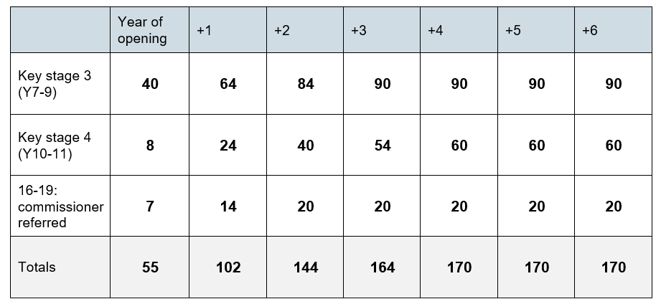
Proposed SEMH Specialist Free School
Growth Plan
The expectation is that DfE works will start on site in Summer 2025 and the new school will be delivered in academic year 2026/27. Full capacity needs to be achieved within 4 years of opening to meet forecast demand for state-maintained specialist school places.

Slide 8
Outcomes we want the school to achieve for pupils
Outcome 1: Reduction in the stigma associated with social, emotional and mental health needs so that children and young people feel their contributions to their school and local communities are welcomed, supported, and valued, and no-one is left behind.
Outcome 2: Inclusive and equitable access to high quality local education that gives families greater choice and control and means that vulnerable pupils with SEMH needs who are resident in the north of the county can attend their nearest most appropriate co-educational state-maintained school.
Outcome 3: Reduction in home to school journey times, including the development of independent travel skills using sustainable transport options.
Outcome 4: Development of resilience and independence skills so that pupils with SEMH needs can lead independent and fulfilling lives in their own communities and manage the normal stresses of everyday life effectively.
Outcome 5: Reduction in the number of Surrey children and young people with SEMH needs who are excluded from school or miss out on education for another reason.
Outcome 6: Increased numbers of Surrey children and young people with SEMH needs who successfully remain in mainstream education and/or successfully transition back to mainstream provision from specialist provision.
Outcome 7: Surrey’s schools, FE colleges and other providers are able to successfully support children and young people with SEMH needs to live, learn and grow up locally and achieve their full potential so that they make better educational progress and achieve academic qualifications.
Outcome 8: More young people with SEMH needs successfully engage in further education and/or employment.

Slide 9
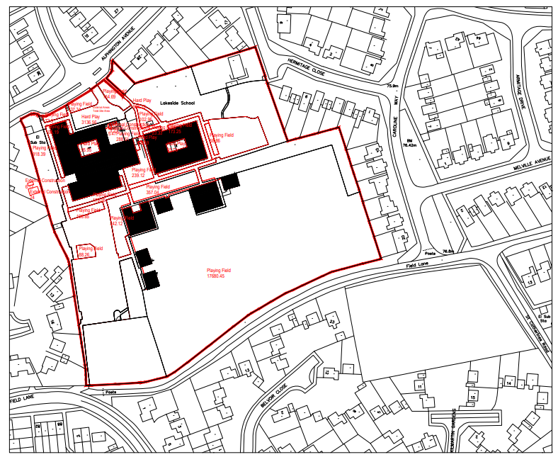
Proposed SEMH Specialist Free School Location
The site is the current Lakeside Primary School (Kite Academy Trust) site of up to 2.8 hectares at Frimley near Camberley and will be vacant from September 2023.
Alphington Avenue
Frimley
Camberley
GU16 8LL
The site needs to be cleared and existing school to be demolished in order to create the new specialist free school for 170 pupils aged 11-19 years

Slide 10
Developing your Proposal
All of Create: Schools Services are funded by the DfE and are provided completely free of charge.
Create: Schools works directly with free school proposer groups to help them navigate the process of applying for a new specialist free school through the DfE Central wave.
Proposer Groups who are successfully enrolled onto the programme will be assigned a named Create: Schools Advisor who will:
Answer any questions
Review, develop, draft and refine applications
Work with proposers to build partnerships and ensure partnerships are aligned
Ensure key milestones are reached (Round 1 Application Submission Deadline)
Secure an interview with SCC and DfE (Round 2 Shortlist Proposer Applications) to be approved to open the new Specialist Free School.
Prior to submission, applications will be assessed against the standardised Bid Audit Template, which is matched exactly against SCC’s published School Specification.

Slide 11
Completing your Application
Proposals need to:
Have a clear vision for how the proposed school will improve outcomes and enhance the life chances of children and young people within the local community.
Show that the school will deliver Surrey’s local authority specification within the funding specified, demonstrate a commitment to forming and working in local partnerships, and be evidence-based with a clear implementation plan.
Evidence a clear understanding of the needs of the expected cohort and demonstrate the ability to successfully meet those needs and achieve key outcomes for children and young people.
Demonstrate a strong track record of providing a high standard of education.
Demonstrate how the school will set ambitious and realistic expectations for children and young people from the outset, and support them towards effective preparation for adulthood.
Offer good value for money, with an affordable education plan.
Show a strong understanding of the teacher recruitment and retention issues that the school might face, taking into account any local, regional or national factors relevant to your context, with clear planned mitigations.
Include specific plans of how teacher workload will be managed and kept under review so that it is sustainable as the school grows to full capacity.

Slide 12
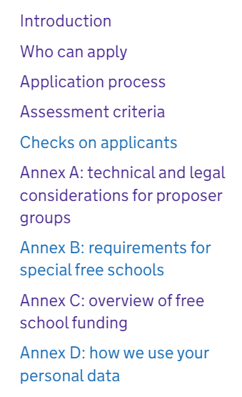
Application Assessment Criteria
Section A: Applicant details
Section B: The School
Section C: Vision (No more than 1,000 words)
Section D: Educational plan
Section D1: Curriculum plan (No more than 2,000 words)
Section D2: Measuring pupil performance and setting challenging expectations (No more than 2,000 words)
Section D3: Staffing (No more than 2,000 words)
Section D4: Integration & community cohesion (No more than 750 words)
Section E: Capacity and capability
Section E1: A strong educational track record (No more than 500 words)
Section E2 The necessary experience and credentials to deliver the school to opening (No more than 2,500 words)
Section E2: An effective governance structure (No more than 1,500 words)
Section F: Financial Viability (Excel financial template)
Notes:
Finance plan must be focused on delivering educational outcomes. Project Development Grant (revenue) will be funded by DfE – initial allocation of £30k (to cover all pre-opening costs), and then the balance of the PDG funds (totalling around £220k) will be paid in instalments after the provisional opening date has been agreed.

Slide 13
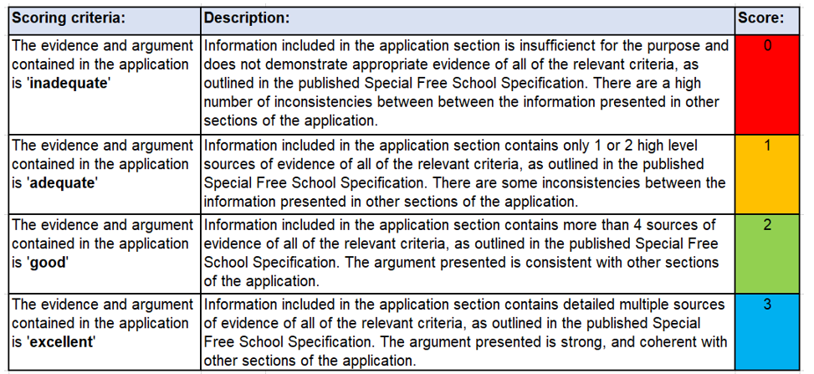
Application Assessment Criteria

Slide 14
Key Timescales
DATE | ACTION
28 April 2023 | LAs confirm details in the school specification and send the link to where specification have been published on the LA website to fs.applications@education.gov.uk
9 May 2023 | DfE Publish the How to apply Guidance and school specifications on GOV.UK with link to LA local contextual information and opens pre-registrations and application window.
From 9 May 2023 | LAs hold engagement events with prospective trusts. Support from Create: Schools will be provided. https://www.createschools.co.uk
26 May 2023 | Deadline for SCC to submit updated Impact Assessment (IA) and EqIA
16 June 2023 | DfE Pre-registration window closes.
31 August 2023 | DfE Application window closes.
End Oct 2023 | Assessment of Trust applications ends. LAs will be required to feed in any intelligence on applications being assessed in their areas and views on applications being put forward for interviews.
Nov-Dec 2023 | Trust interviews. A SCC representative will sit on the panel for all interviews pertaining to the LAs approved special school.
Jan 2024 | Secretary of State for Education to announce successful Trusts.

Slide 15
Next Steps
We will share a copy of these slides with all registered attendees.
Once the links go live on 9 May 2023 carefully read through the DfE ‘How to Apply Guidance’, the published School Specification and the existing publication ‘Free Schools: Pre-Opening Guide’.
You should use the information within the published School Specification and contextual information to determine whether you would like to apply to open and run the school.
Join us for the formal engagement events on Wednesday 17 May from 12pm – 1pm and/ or Tuesday 6 June from 4pm to 5pm. These will be delivered in collaboration with Create: Schools. Register your attendance at schoolorg@surreycc.gov.uk and let us know your preferred date.
If you would like to apply, then you should use the information in the specification as a basis for your application. Enrol with Create: Schools to access their free of change support and guidance after 9 May.
If you are unable to attend the planned proposer group engagement events but would be interested in receiving further information or would like to arrange an informal discussion then please contact Emilie.WilliamsJones@surreycc.gov.uk Programme Manager for Surrey’s SEND and AP Capital Programmes.

Slide 16
Questions & Answer Session

