Slide 1

Universal Open Access Youth Work Consultation – webinar
Lisa Bursill
Assistant Director Early Help and Hubs
Family Resilience and Safeguarding
Surrey County Council

Slide 2
Our Ambitions for Children in Surrey
That every child in Surrey should have the opportunity to reach their potential and we also believe that the best place for children to be supported to grow and achieve this is within their own families
By working in collaboration with the voluntary, community and faith sector we can make better use of the resources that already exist.
We have transformed the way we support vulnerable young people and we now want to look at how youth centres support our vision for Surrey that has community participation as one of the priorities.
We want to enable the youth centres to become vibrant places for the benefit of young people and local communities
We look forward to hearing your views about our proposals and working with you as we work together to achieve the best we can for children in Surrey.

Slide 3
Universal Open Access Youth Work Consultation – webinar 24 June 2020
Contents:
Welcome and introductions
Overview of the Surrey County Council Youth Offer
The Consultation Proposals
Next steps and timescales
Questions
Keep text to a minimum with key points and use simple images

Slide 4
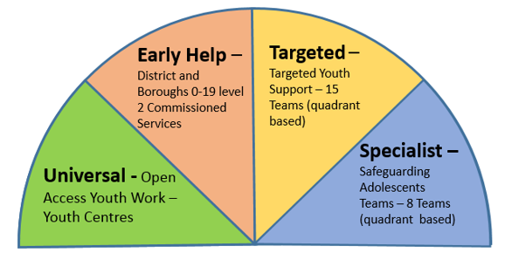
The Surrey County Council (SCC)
Youth Offer
.

Slide 5
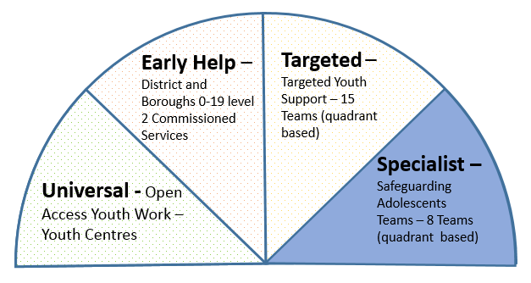
Safeguarding Adolescents Teams
8 Safeguarding Adolescents Teams
Provides the statutory response for young people in need of help and protection
Strengthening statutory responses to tackling exploitation and county lines
Located in quadrant offices alongside Social Workers

Slide 6
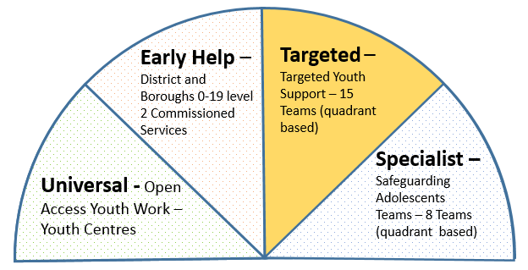
Targeted Youth Support
15 teams across the county
Non statutory work, helping families early
All cases allocated through the Early Help Hub
Supporting young people needs such as exclusion from school, preventing offending, reducing the risk of exploitation, emotional and mental health support

Slide 7
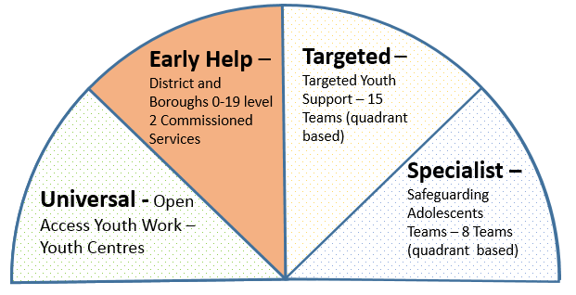
Early Help
Single lead provider for each district and borough
Commissioned Providers:
Reigate and Banstead - YMCA Redhill and Welcare
Rest of County -Surrey Care Trust in partnership with Homestart .

Slide 8
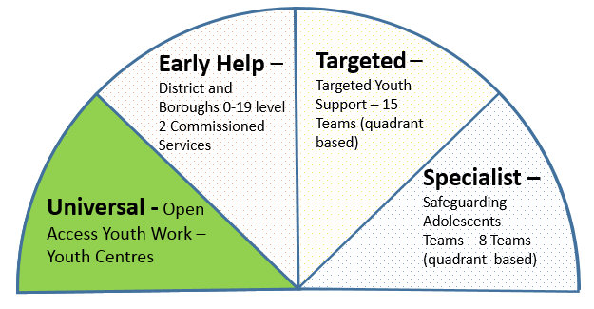
Universal Open Access Youth Work
(this consultation)
Currently spending £975k a year on buildings, £650K on universal open access youth work team
30 youth centres owned or leased by the council.
Small number of additional delivery sites not owned or leased by SCC
Mixture of open access youth work and some closed groups for specific needs

Slide 9
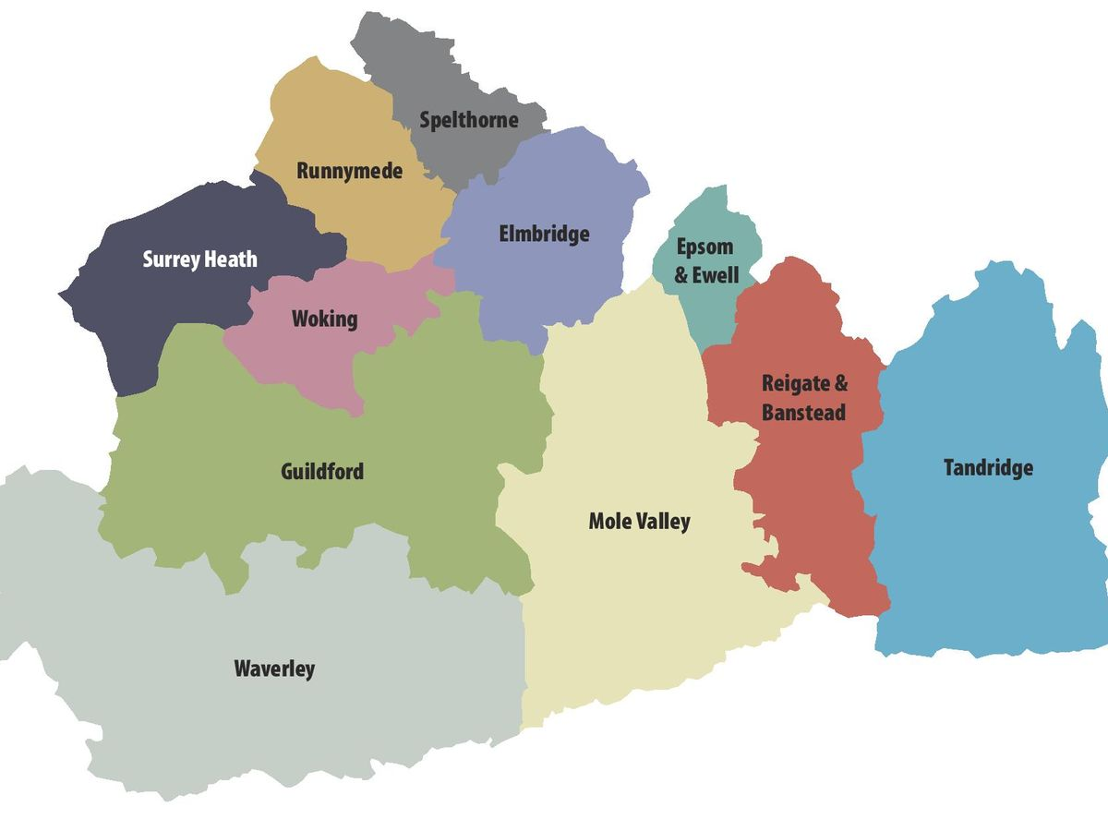
NORTH EAST SURREY
Claygate
Molesey, West Molesey
Walton, Walton on Thames
Focus, Epsom
The Edge, Epsom
Stanwell, Staines
Leacroft, Staines
Shepperton
Ashford
Sunbury, Sunbury on Thames
Youth Centres in scope
NORTH WEST SURREY
Sheerwater, Woking
Addlestone
Old Dean, Camberley
Egham
Frimley Green
WYAC, Woking
Lakers, Woking
SOUTH WEST SURREY
Sandy Hill, Farnham
Ash, Aldershot
Discovery, Guildford
SOUTH EAST SURREY
The Bridge, Leatherhead
Horley
The Malthouse, Dorking
Ashtead
Phoenix, Tadworth
Banstead
The Annex, Redhill
The Street, Caterham
Harrys, Oxted
Merstham Hub

Slide 10
Why are proposing a different approach?
Most Youth Centres are not being used to their full potential but are often valued by the community.
No statutory duty for SCC to provide open access universal youth work but we need to do more to support young people in need of help within existing resources.
The voluntary, community and faith sector are already the biggest providers of youth work in the County but affordable access to buildings can be challenging.

Slide 11
The Youth Offer Strategy
There are no budget savings attached to the proposals
Surrey County Council is proposing a strategy for making more effective use of buildings and deploying council employed youth workers differently.

Slide 12
The Consultation Proposals………
Whether SCC enables the voluntary, community and faith sector to provide services for young people from existing youth centres for little or no cost
Whether SCC provides universal open access youth work

Slide 13
What could this look like – no single solution but could include:
Supporting the creation of management committees and providing them with a lease for the building with an agreed set of outcomes.
Providing leases to already established organisations with an agreed set of outcomes.
Agreeing what type of use and lease arrangement could be for little or no cost to the provider.
Providing short term pump prime grant funding for organisations that need help to get established.
Enabling mixed use of the building with other SCC services and partners.

Slide 14
SCC Youth Work Delivery
Feedback from this consultation and the views of over 1200 young people will be used to inform the priorities
Learning from recent arrangements during Covid-19 and models of best practice will inform potential service design

Slide 15
How to get involved? – Consultation Website:
https://www.surreysays.co.uk/csf/universal-youth-work-proposal/
(Open until midnight on the 30th June 2020)

Slide 16
What if I am interested in providing services at any of the youth centres?
Expressions of interest mailbox:
youthcentres.reginterest@surreycc.gov.uk

Slide 17
What happens next?
Consultation feedback analysed and equality impact assessment completed in July
Recommendations and strategy decisions made in August
Individual plans for centres developed from September onwards with timescales relevant to each centre.

Slide 18
Questions? – use the Q&A function on the right hand side to post questions

Slide 19
Thank you for taking part
https://www.surreysays.co.uk/csf/universal-youth-work-proposal/
(Open until midnight on the 30th June 2020)
Expressions of interest mailbox:
youthcentres.reginterest@surreycc.gov.uk

